Slide 1
PCN Community Pharmacy Leads Update September 2020
Tom Kallis
Project Pharmacist, Devon LPC

Slide 2
Agenda
Sponsor – Chiesi Ltd
Effective team working and collaboration
PCN Contract Update
Strategy Update by David Bearman
Pharmacy Quality Scheme
Q&A and Close
Notes:
Introduce speakers
Etiquette for asking questions and interacting

Slide 3
Our Sponsor Tonight
Jason Couch
Senior Integrated Account Manager
Chiesi Ltd

Slide 4
What makes a successful team?

Slide 6
Effective Team Working
Telos – What is the purpose? What are the results?
What is the communications network within the group like?
Collaboration and Negotiation

Slide 8
Interfacing with PCNs
Agree your principles within the pharmacy network
What are the measures of success (SMART!)
What’s the capacity?
Who’s in the room?
Relationships

Slide 9
Future Leadership Training
Interpersonal relationships, comms and stakeholder management
Working effectively as teams
Motivation, engagement and leading during uncertain times
Strategic thinking and negotiating
Decision making and working in ambiguous situations
Conflict resolution and difficult conversations

Slide 10
PCN Contract Update

Slide 11
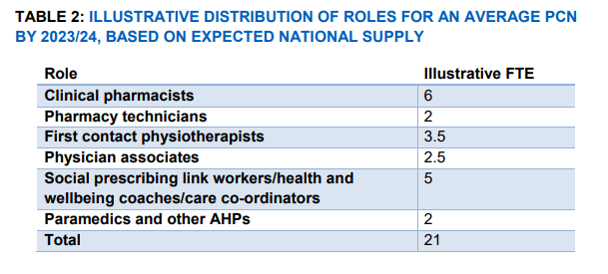
Key GP Contract Updates
Enhanced ARRS
Releasing time to care
PCN DES
IIF: Impact and Investment Fund

Slide 12
PCN DES
Structured medication reviews and optimisation
Enhanced health in Care Homes
Anticipatory Care
Supporting Early Cancer Diagnosis
Personalised Care
CVD Prevention and Diagnosis
Tackling Neighbourhood Inequalities

Slide 13
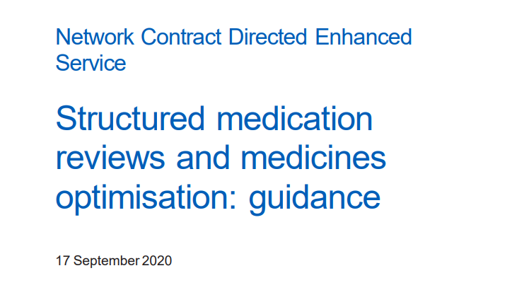
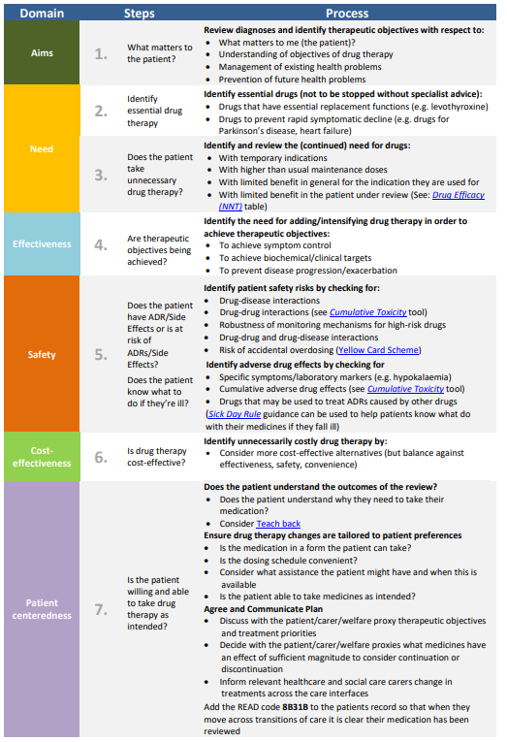
What is a Structure medication Review (SMR?)
Provided by a suitably qualified professional – Pharmacists in the first instance
Launches October 1st 2020
Defined population by the PCN
PCNs to offer dedicated slots for proactive SMRs and follow ups, volume agreed with CCGs
PCNs are required to work with community pharmacies to connect patients appropriately to NMS

Slide 14
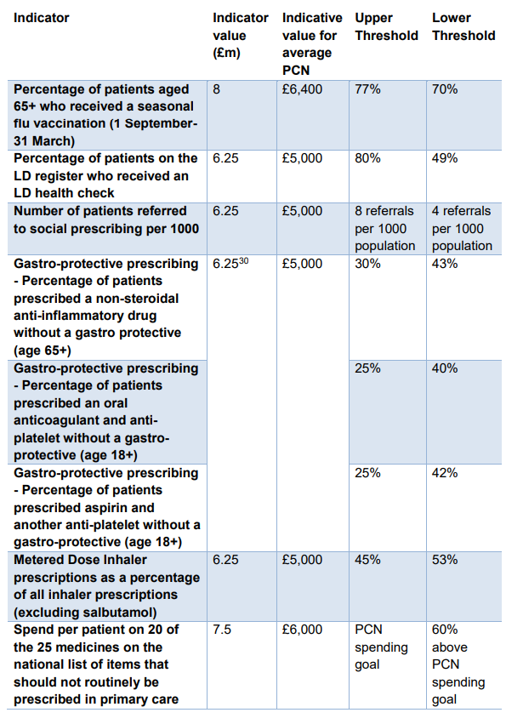
Impact and Investment Fund

Slide 15
Areas of Overlap
Electronic Repeat Dispensing
Discharge Medications and NMS
Winter Flu Vaccinations (esp. over 65s)
Medicines Safety
Urgent care (low acuity conditions) and capacity

Slide 16
Pharmacy Quality Scheme: A PCN Lead’s Guide

Slide 17
Domains
Infection Control and AMS
Prevention
Risk Management
PCN: Prevention
PCN: Business Continuity

Slide 18
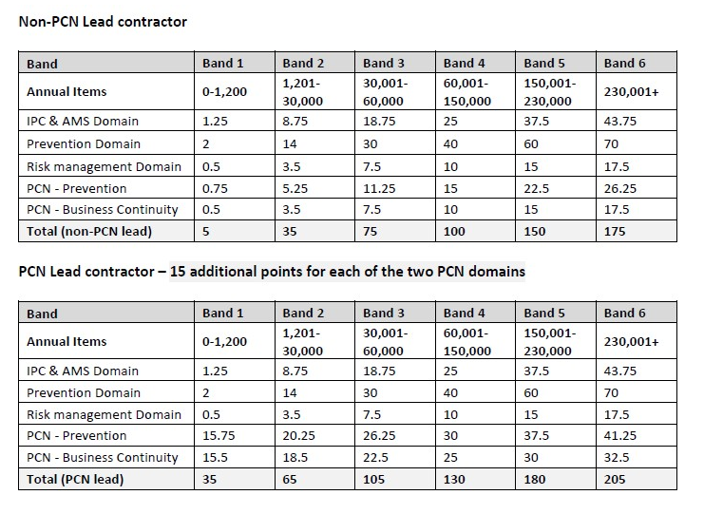

Slide 19
PCN Domains: Pre-emptive questions
Do you know the PCN to which your pharmacy is aligned?
Do you know your PCN Community Pharmacy Lead?
Do you know your PCN Pharmacy Lead’s pharmacy name and ODS code?
Communications Network?

Slide 20
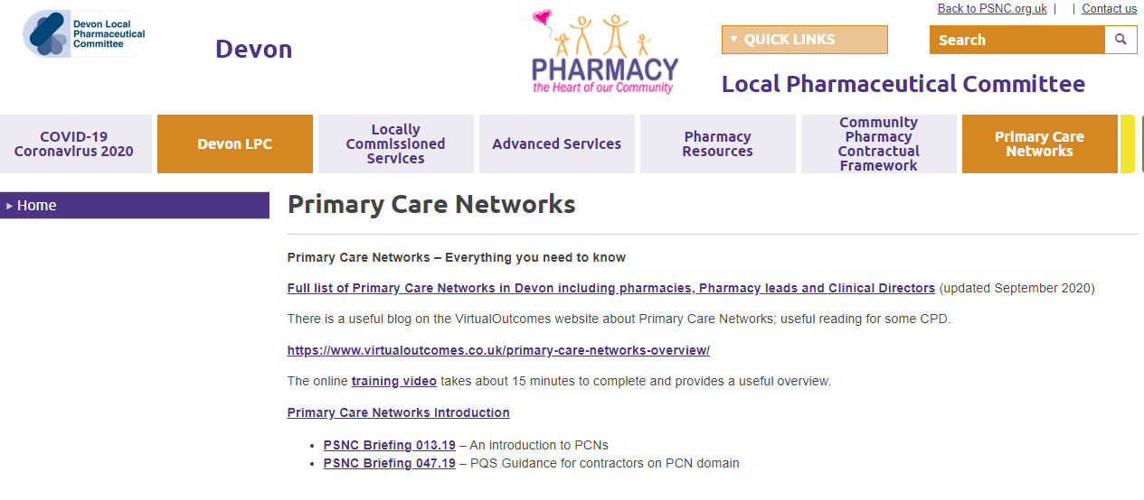

Slide 21
PCN: Business Continuity
All contractors in a PCN that wish to complete the requirements of this domain, must have participated in a discussion, organised by the Pharmacy PCN lead, regarding business continuity planning

Slide 22
PCN: Business Continuity
The PCN Lead must:
1. Facilitate a discussion between contractors, ensuring the group are aware of the top level business continuity plans of other contractors.
2. Liaise with PCN Clinical Director (or appointed lead) to gain an understanding of business continuity plans for GP practice, should a practice have to close. This should be shared with the community pharmacies within the network also
3. Collate the following information from each participating contractor and share this with all the contractors within the PCN, the PCN Clinical Director, the Local Pharmaceutical Committee and the NHSE&I regional team: contractor contact details for use in an emergency, the names of the pharmacies and general practices that are most likely to be significantly impacted by a temporary closure of each pharmacy (as a result of patient flows) and the high-level details of any arrangements that have been put in place with them which will be activated in the case of the contractor needing to temporarily close their pharmacy.

Slide 23
Business Continuity
The contractor must have demonstrable evidence, at the pharmacy, that the discussions and contractor actions described were completed and, where necessary, updates have been made to the pharmacy business continuity plan, to reflect the collaborative work required in the event of closures.
In addition, the Pharmacy PCN Lead must have demonstrable evidence of having undertaken the tasks described.

Slide 24
PCN Lead MYS Declaration
Declarations that they have facilitated and organised a the group business continuity discussion for all contractors in the PCN who want to take part
ODS codes of the pharmacies that have taken part
The name of the PCN
Declaration that they are the PCN lead
A declaration that the lead has informed the LPC that they are the lead for the PCN

Slide 25
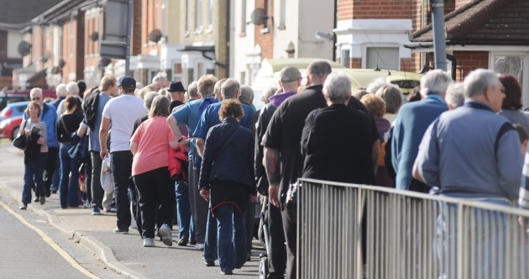
PCN: Prevention
Contractors:
Need to engage with the PCN lead to communicate they would like to be involved in uptake of vaccinations of over 65s
Need to demonstrably have contributed to the PCN having achieved at or above a specified percentage of population over 65 being vaccinated against flu.
Leads:
Engage with pharmacies that want to be involved, agree collaborative measures and how they can collaborate with GP practices AND engage with PCN Clinical director to agree what collaborative approaches could be taken

Slide 26
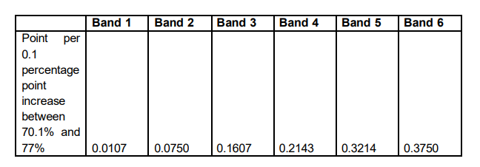

Slide 27
PCN Lead MYS Declaration
Declaration that the lead has engaged with the PCN Clinical Director to agree how community pharmacies in the PCN will collaborate with GPs to increase the uptake the flu vaccination in patients over 65 years old
Total number vaccinated 65+ between 1st September 2020 and 31st January 2021
ODS codes of pharmacies that have engaged with the collaborative process
Declaration that they are the appointed lead (and have notified the LPC)
Name of PCN

Slide 28
Summary of Key Points
eRD toolkit launch
Offer of a facilitated session
Reflection on comms network
Business Continuity Plans
Flu conversation
Feedback Survey Please

